Slide 1
Accent Detection in the UK
Mark Streer • METIS (DS/ML) • 2021-10-29

Slide 2
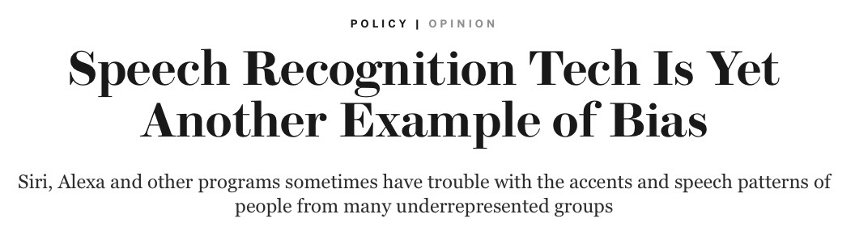





Dialects, Accents & Algorithmic Bias

Slide 3


A Different Solution
Specific language models for specific accents/dialects
Pretrain models on data from single accent (or group)
Determine speaker’s accent based on first utterances (0~3 s)
Process speech using selected model
Applications
Customer service (call centers)
Subtitling & transcription
International espionage

Slide 4
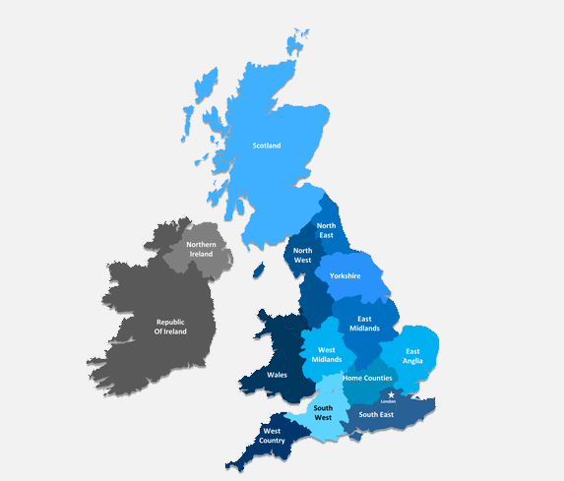
The Data
Open-­source Multi-­speaker Corpora of English Accents in the British Isles
Created by Google Research (Demirsahin et al. 2020)
Raw data available at OpenSLR.org
1 entry = 3~10s spoken sentence by single speaker + transcript
>18k entries

Slide 5
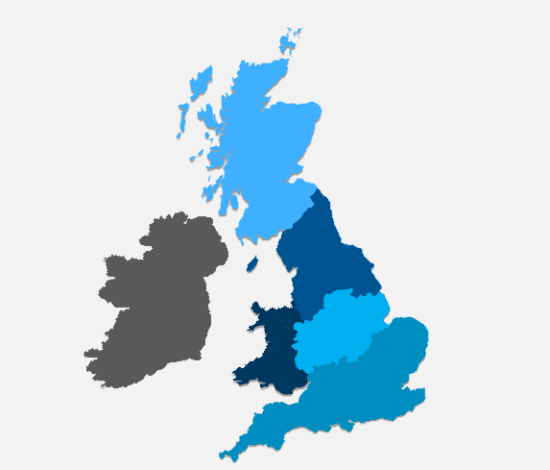
The Data
Open-­source Multi-­speaker Corpora of English Accents in the British Isles
Created by Google Research (Demirsahin et al. 2020)
Raw data available at OpenSLR.org
1 entry = 3~10s spoken sentence by single speaker + transcript
>18k entries
Six groups of dialects/accents
Southern (English)
Northern (English)
Scottish
Welsh
Midlands (English)
Irish
3.
2.
6.
5.
4.
1.

Slide 6
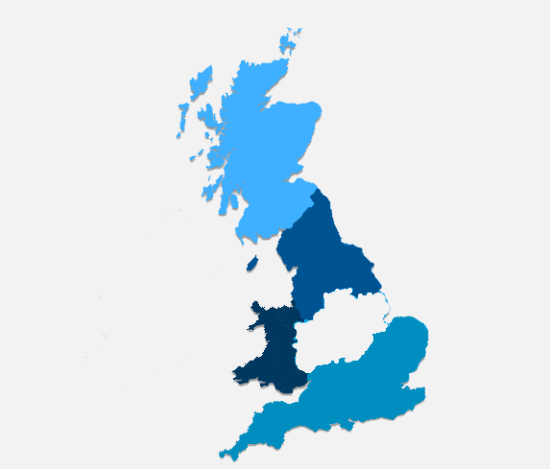


The Data
Open-­source Multi-­speaker Corpora of English Accents in the British Isles
Created by Google Research (Demirsahin et al. 2020)
Raw data available at OpenSLR.org
1 entry = 3~10s spoken sentence by single speaker + transcript
>18k entries
Six groups of dialects/accents
Southern (English)
Northern (English)
Scottish
Welsh
Midlands (English)
Irish
3.
2.
4.
1.

Slide 7
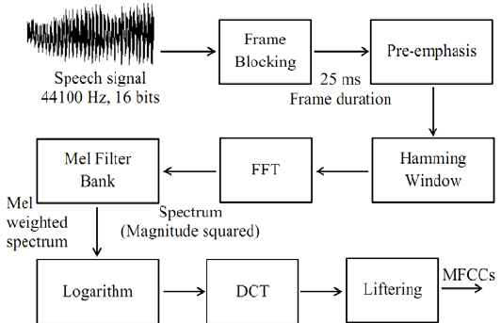
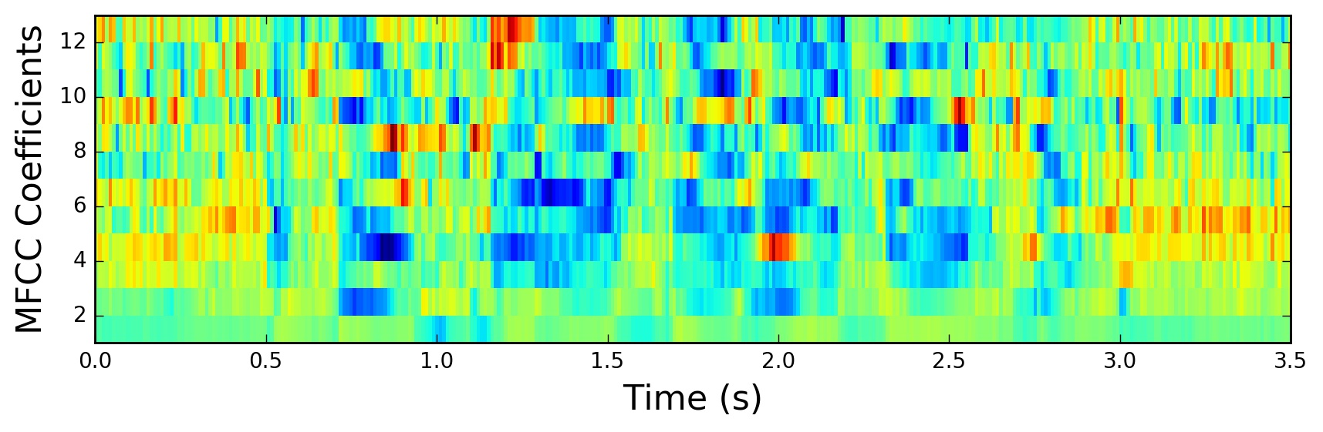
The Features
MFCC
mel-frequency cepstrum coefficients (‘most frequently chosen characteristic’)
Capture sound energy in frequency bands
n=16 typical for speech processing
MFCCΔ, MFCCΔ²
1st, 2nd derivatives of MFCC
Capture changes in MFCCs
Same n as MFCC

Slide 8
The Features
MFCC
mel-frequency cepstrum coefficients (‘most frequently chosen characteristic’)
Capture sound energy in frequency bands
n=16 typical for speech processing
MFCCΔ, MFCCΔ²
1st, 2nd derivatives of MFCC
Capture changes in MFCCs
Same n as MFCCs didn’t raise scores

Slide 9
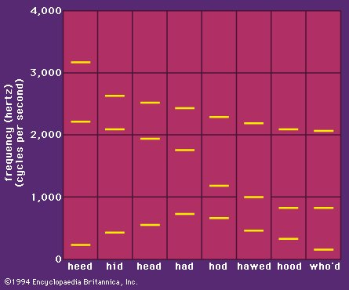
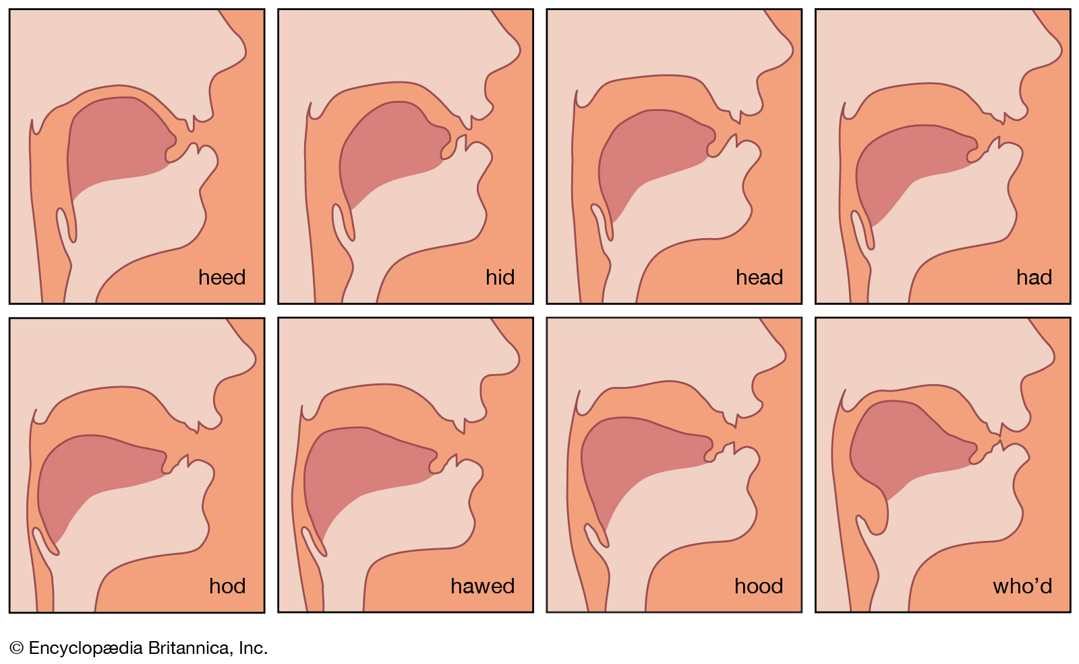
The Features
Formants
F₁, F₂, F₃, F₄
Standardize by speaker (divide by F₀)
Mean, median over recording

Slide 10
The Features
Formant ratios: F₂ ÷ F₁
Vowel pronunciation (‘raised-ness’)
High = tend to be close, front
Low = tend to be open, back
2
2
1
1

Slide 11
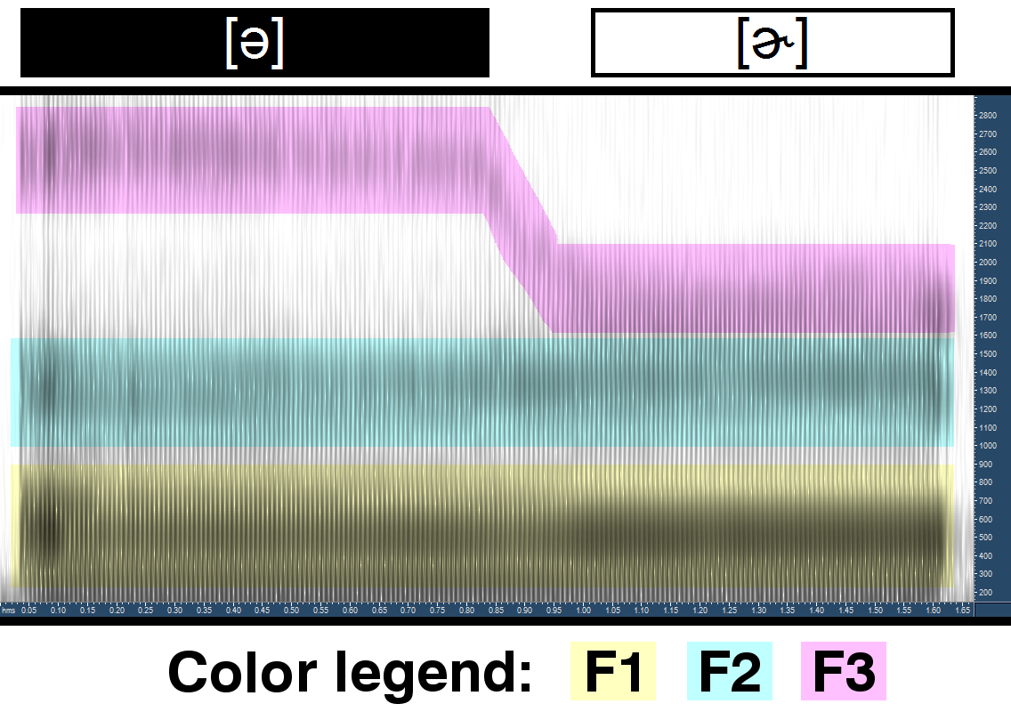
The Features
Formant ratios: F₃ ÷ F₂ F₃ ÷ F₁
Rhoticity (‘r-ness’)
High = Less rhotacized
Low = More rhotacized
Lip rounding
High = Less rounding
Low = More rounding
(F₃ itself better indicator)

Slide 12
Model Performance
Multi-class OVR
Dialect | KNN5 (k=5) | Logistic (C=0.1) | DTC16 (max_depth=16) | RF100 (n_estimators = 100) | XGBoost (params via GridSearchCV) | NB
Southern | 0.53 | 0.74 | 0.53 | 0.66 | 0.57 | 0.68
Northern | 0.16 | 0.35 | 0.17 | 0.05 | 0.75 | 0.20
Welsh | 0.30 | 0.54 | 0.34 | 0.46 | 0.85 | 0.00
Scottish | 0.21 | 0.19 | 0.26 | 0.18 | 0.74 | 0.00
Mean Accuracy (weighted) | 0.38 | 0.55 | 0.39 | 0.45 | 0.55 | 0.37
F₁

Slide 13
Model Performance
Multi-class OVR (class_weight=‘balanced’)
Dialect | KNN5 | Logistic | DTC16 | RF100 | XGBoost | NB
Southern | 0.53 | 0.74↘︎0.70 | 0.53↗︎0.56 | 0.66↗︎0.67 | 0.57 | 0.68
Northern | 0.16 | 0.35↗︎0.41 | 0.17↗︎0.18 | 0.05↗︎0.28 | 0.75 | 0.20
Welsh | 0.30 | 0.54↘︎0.52 | 0.34↘︎0.17 | 0.46↘︎0.15 | 0.85 | 0.00
Scottish | 0.21 | 0.19↗︎0.25 | 0.26↗︎0.35 | 0.18↗︎0.29 | 0.74 | 0.00
Mean Accuracy (weighted) | 0.38 | 0.55 | 0.39 | 0.45 | 0.55 | 0.37
F₁
Ranking: XGBoost ≅ Logistic >> RF100 >> DTC16 > KNN5 > NB

Slide 14
Feature Importance
(Logistic) | Northern |  | Scottish |  | Southern |  | Welsh |  | Related to
F3/F1_median | -0.82 | #4 | -2.00 | #2 | 1.25 | #1 | 1.57 | #2 | Rhoticity (+rounding)
F1_median (F1_mean) | -1.28 | #1 | -1.68 (-2.33) | #3 (#1) | 0.89 | #4 | 0.25 (2.21) | #3 (#1) | Vowel height
F2/F1_mean | + |  | 1.62 | #4 | -0.95 | #2 | -0.97 | #4 | Vowel compactness
F3_mean | 0.98 | #2 | — |  | -0.93 | #3 | + |  | Lip rounding
F3/F2_median | -0.84 | #3 | + |  | + |  | + |  | Rhoticity (+rounding)

Slide 15
Feature Importance
(Logistic) | Northern |  | Scottish |  | Southern |  | Welsh |  | Related to
F3/F1_median | -0.82 | #4 | -2.00 | #2 | 1.25 | #1 | 1.57 | #2 | Rhoticity (+rounding)
F1_median (F1_mean) | -1.28 | #1 | -1.68 (-2.33) | #3 (#1) | 0.89 | #4 | 0.25 (2.21) | #3 (#1) | Vowel height
F2/F1_mean | + |  | 1.62 | #4 | -0.95 | #2 | -0.97 | #4 | Vowel compactness
F3_mean | 0.98 | #2 | — |  | -0.93 | #3 | + |  | Lip rounding
F3/F2_median | -0.84 | #3 | + |  | + |  | + |  | Rhoticity (+rounding)
Vowels sound… | Open |  | Open |  | Close |  | Close

Slide 16
Feature Importance
(Logistic) | Northern |  | Scottish |  | Southern |  | Welsh |  | Related to
F3/F1_median | -0.82 | #4 | -2.00 | #2 | 1.25 | #1 | 1.57 | #2 | Rhoticity (+rounding)
F1_median (F1_mean) | -1.28 | #1 | -1.68 (-2.33) | #3 (#1) | 0.89 | #4 | 0.25 (2.21) | #3 (#1) | Vowel height
F2/F1_mean | + |  | 1.62 | #4 | -0.95 | #2 | -0.97 | #4 | Vowel compactness
F3_mean | 0.98 | #2 | — |  | -0.93 | #3 | + |  | Lip rounding
F3/F2_median | -0.84 | #3 | + |  | + |  | + |  | Rhoticity (+rounding)
Vowels sound… | Low |  | Low |  | High |  | High

Slide 17
Feature Importance
(Logistic) | Northern |  | Scottish |  | Southern |  | Welsh |  | Related to
F3/F1_median | -0.82 | #4 | -2.00 | #2 | 1.25 | #1 | 1.57 | #2 | Rhoticity (+rounding)
F1_median (F1_mean) | -1.28 | #1 | -1.68 (-2.33) | #3 (#1) | 0.89 | #4 | 0.25 (2.21) | #3 (#1) | Vowel height
F2/F1_mean | + |  | 1.62 | #4 | -0.95 | #2 | -0.97 | #4 | Vowel compactness
F3_mean | 0.98 | #2 | — |  | -0.93 | #3 | + |  | Lip rounding
F3/F2_median | -0.84 | #3 | + |  | + |  | + |  | Rhoticity (+rounding)
Vowels sound… | Front |  | Front |  | Back |  | Back

Slide 18
Feature Importance
(Logistic) | Northern |  | Scottish |  | Southern |  | Welsh |  | Related to
F3/F1_median | -0.82 | #4 | -2.00 | #2 | 1.25 | #1 | 1.57 | #2 | Rhoticity (+rounding)
F1_median (F1_mean) | -1.28 | #1 | -1.68 (-2.33) | #3 (#1) | 0.89 | #4 | 0.25 (2.21) | #3 (#1) | Vowel height
F2/F1_mean | + |  | 1.62 | #4 | -0.95 | #2 | -0.97 | #4 | Vowel compactness
F3_mean | 0.98 | #2 | — |  | -0.93 | #3 | + |  | Lip rounding
F3/F2_median | -0.84 | #3 | + |  | + |  | + |  | Rhoticity (+rounding)
Vowels sound… | Unrounded |  | Rounded |  | Rounded |  | Unrounded

Slide 19
Feature Importance
(Logistic) | Northern |  | Scottish |  | Southern |  | Welsh |  | Related to
F3/F1_median | -0.82 | #4 | -2.00 | #2 | 1.25 | #1 | 1.57 | #2 | Rhoticity (+rounding)
F1_median (F1_mean) | -1.28 | #1 | -1.68 (-2.33) | #3 (#1) | 0.89 | #4 | 0.25 (2.21) | #3 (#1) | Vowel height
F2/F1_mean | + |  | 1.62 | #4 | -0.95 | #2 | -0.97 | #4 | Vowel compactness
F3_mean | 0.98 | #2 | — |  | -0.93 | #3 | + |  | Lip rounding
F3/F2_median | -0.84 | #3 | + |  | + |  | + |  | Rhoticity (+rounding)
Vowels sound… | Not rhotic |  | Rhotic |  | Rhotic |  | Rhotic

Slide 20
Future Directions
Run modeling separately by gender
Check only first (or last) 1~3 sec of recordings
Include more audio features (e.g., jitter, shimmer)
Ethical ramifications of profiling

